Slide 1
A TOUR IN THE haunted HOUSE
By amine AND AMEL

Slide 2
Game description
In this games u will be playing as a little child
Your story begin when u started playing with your favourite ball in your neighborhood until suddenly u shoot the ball into a window of a creepy old house and break it
Your goal is to find the ball and leave the house without causing any more troubles

Slide 3
Game rules
You have at the end of the circuit 2 lights , the red is your life and the yellow is the ball , u must turn both lights on
In the circuit there are 6 columns , in one column there are 4 led lights , u must turn on only one
Each light represent your action whether its go right or left or up or down
There is a blue light between the third and the fourth column it represent eating the cake or not
WARNING: DO NOT EAT THE CAKE

Slide 4
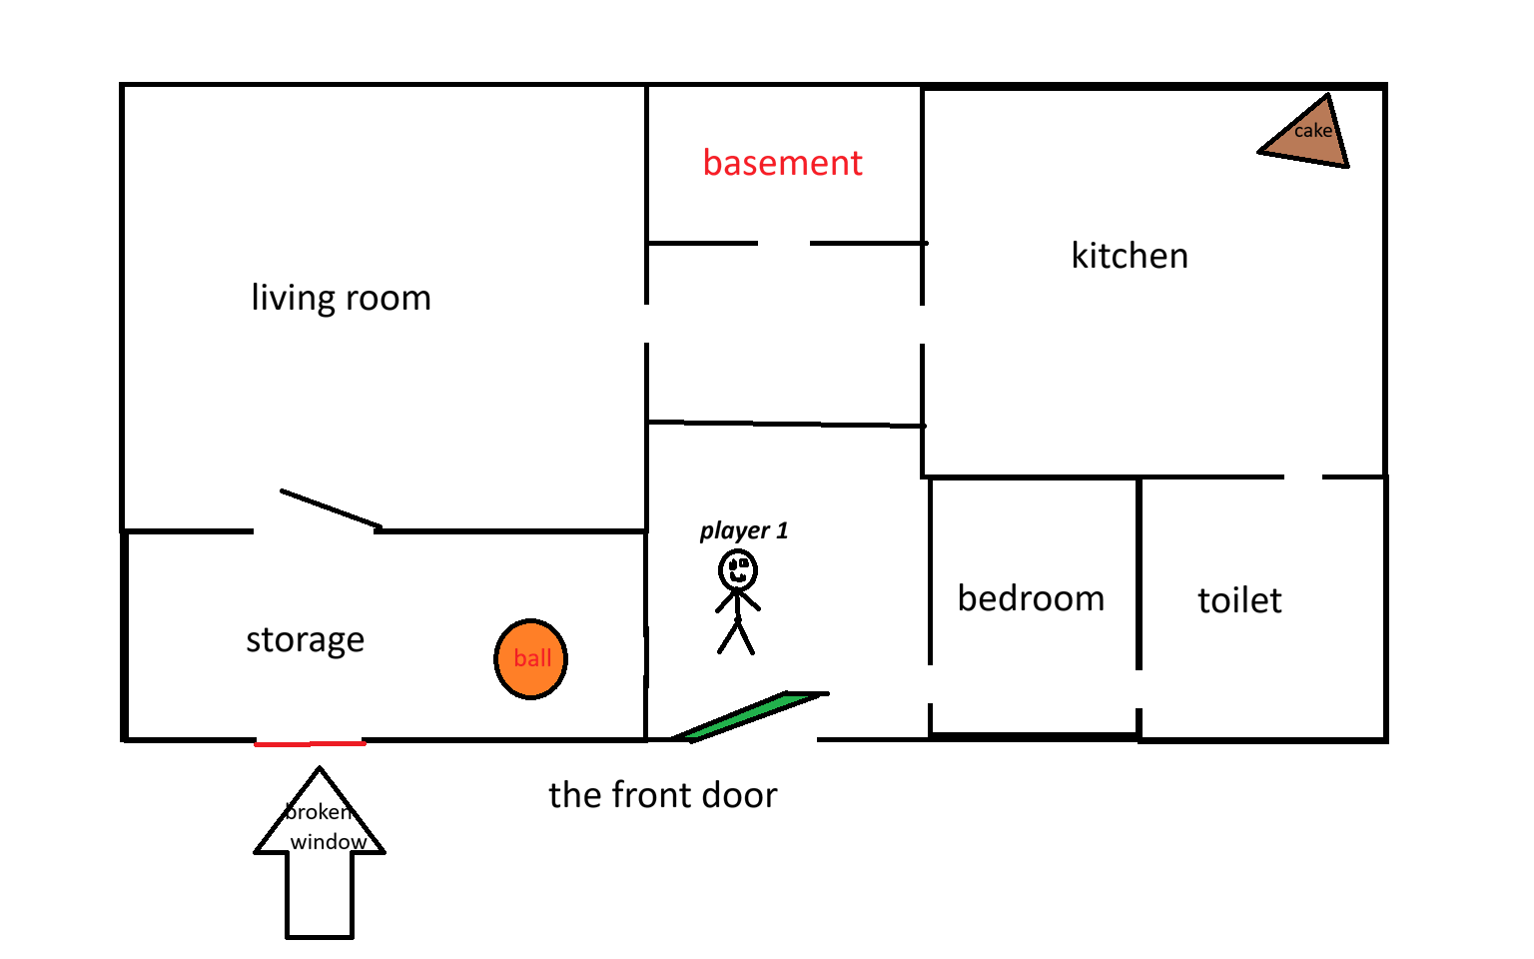
The map of the house

Slide 5
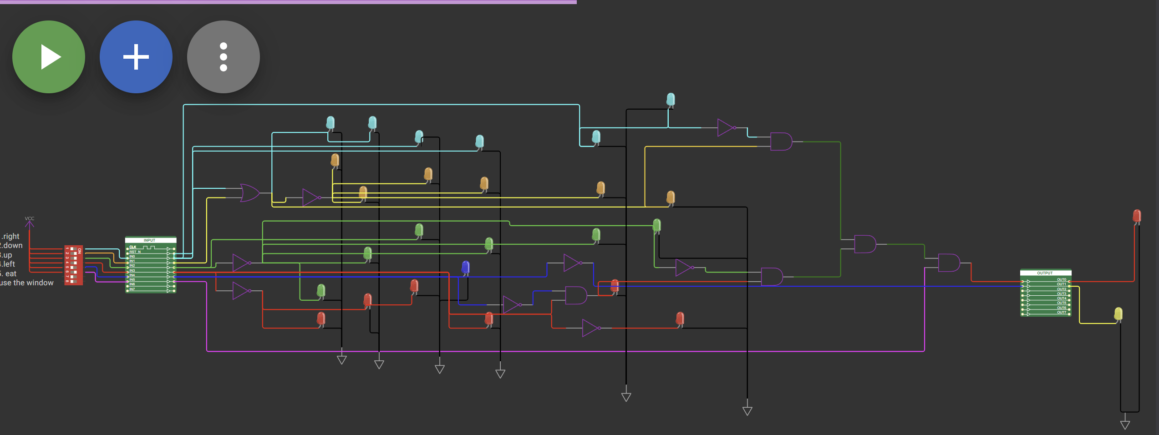
The simulation of the game

Slide 6
The link of our work in wokwi :
https://wokwi.com/projects/458951258752539649

